Slide 1



TWO-LEVEL
DIRECTORY
PROGRAM
#DSC

Slide 2

Project vision and mission
A two-level directory is a simple hierarchical file system with two layers: a root directory and user directories within it. Each user directory contains files specific to that user. It helps organize files better, avoids name conflicts, and is useful in systems where multiple users need independent file management
#DSC

Slide 3



by implementing operations such as creating directories
Objective
by implementing operations such as adding files
The main goal of the two-level directory program in C is to simulate file management by implementing operations. This program illustrates the principles of hierarchical file systems.
by implementing operations such as searching files and deleting files or directories and displaying the directory
#DSC

Slide 4


Concept
The two-level directory system includes:
Root Directory: Acts as a parent directory containing multiple user directories
User Directories: Subdirectories within the root directory to store user file.
The hierarchical separation helps users manage their files without interfering with others and improves accessibility.
#DSC

Slide 5
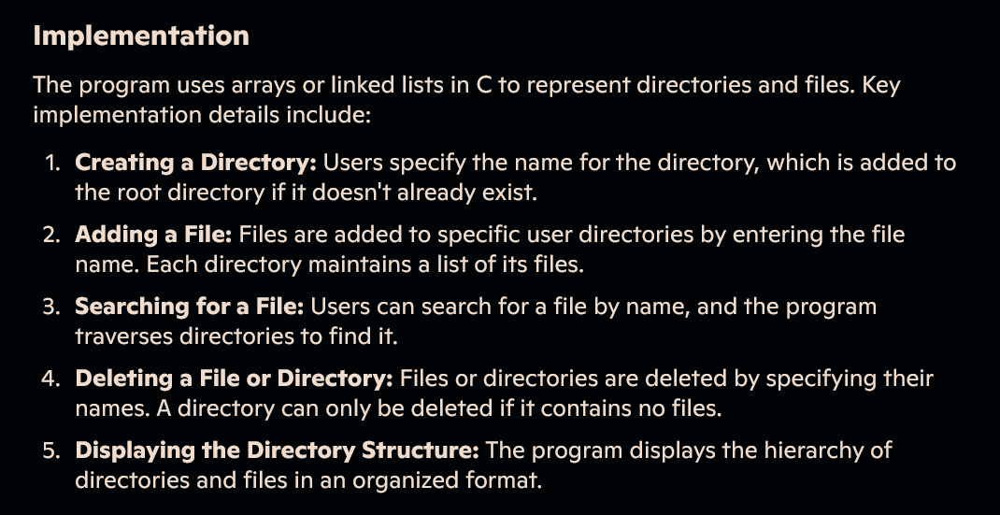
Creation process
#DSC

Slide 6
#DSC
code
// Function to create a user directory
void createUserDirectory() {
if (userCount >= MAX_USERS) {
printf("Maximum user directories reached!\n");
return;
}
printf("Enter User Name: ");
scanf("%s", users[userCount].name);
users[userCount].fileCount = 0;
userCount++;
printf("User Directory Created Successfully!\n");
}
// Function to add a file to a user directory
void addFile() {
char userName[NAME_LEN], fileName[NAME_LEN];
printf("Enter User Name: ");
scanf("%s", userName);
for (int i = 0; i < userCount; i++) {
if (strcmp(users[i].name, userName) == 0) {
if (users[i].fileCount >= MAX_FILES) {
printf("File limit reached for this user!\n");
return;
}
#include <stdio.h>
#include <stdlib.h>
#include <string.h>
// insted of this #include "myheaders.h" we can use
#define MAX_USERS 10
#define MAX_FILES 10
#define NAME_LEN 20
// in a single line #define MAX_USERS 10, MAX_FILES 10, NAME_LEN 20 check it out once
// Structure for File
typedef struct {
char name[NAME_LEN];
} File;
// Structure for User Directory
typedef struct {
char name[NAME_LEN];
int fileCount;
File files[MAX_FILES];
} UserDirectory;
UserDirectory users[MAX_USERS];
int userCount = 0;
// Function to create a user directory
void createUserDirectory() {
if (userCount >= MAX_USERS) {
printf("Maximum user directories reached!\n");
return;
}
printf("Enter User Name: ");
scanf("%s", users[userCount].name);
users[userCount].fileCount = 0;
userCount++;
printf("User Directory Created Successfully!\n");
}
// Function to add a file to a user directory
void addFile() {
char userName[NAME_LEN], fileName[NAME_LEN];
printf("Enter User Name: ");
scanf("%s", userName);
for (int i = 0; i < userCount; i++) {
if (strcmp(users[i].name, userName) == 0) {
if (users[i].fileCount >= MAX_FILES) {
printf("File limit reached for this user!\n");
return;
}
printf("Enter File Name: ");
scanf("%s", fileName);
strcpy(users[i].files[users[i].fileCount].name, fileName);
users[i].fileCount++;
printf("File Added Successfully!\n");
return;
}
}
printf("User Not Found!\n");
}
// Function to list files in a user directory
void listFiles() {
char userName[NAME_LEN];
printf("Enter User Name: ");
scanf("%s", userName);
for (int i = 0; i < userCount; i++) {
if (strcmp(users[i].name, userName) == 0) {
printf("Files in User Directory '%s':\n", userName);

Slide 7
if (users[i].fileCount == 0) {
printf("No files available.\n");
return;
}
for (int j = 0; j < users[i].fileCount; j++) {
printf("- %s\n", users[i].files[j].name);
}
return;
}
}
printf("User Not Found!\n");
}
// Function to delete a file from a user directory
void deleteFile() {
char userName[NAME_LEN], fileName[NAME_LEN];
printf("Enter User Name: ");
scanf("%s", userName);
for (int i = 0; i < userCount; i++) {
if (strcmp(users[i].name, userName) == 0) {
printf("Enter File Name to Delete: ");
scanf("%s", fileName);
for (int j = 0; j < users[i].fileCount; j++) {
if (strcmp(users[i].files[j].name, fileName) == 0) {
// Shift files to fill the gap
for (int k = j; k < users[i].fileCount - 1; k++) {
strcpy(users[i].files[k].name, users[i].files[k + 1].name);
}
users[i].fileCount--;
printf("File Deleted Successfully!\n");
return;
}
}
printf("File Not Found!\n");
return;
}
}
printf("User Not Found!\n");
}
#DSC

Slide 8
// Function to delete a user directory
void deleteUserDirectory() {
char userName[NAME_LEN];
printf("Enter User Name: ");
scanf("%s", userName);
for (int i = 0; i < userCount; i++) {
if (strcmp(users[i].name, userName) == 0) {
// Shift users to fill the gap
for (int j = i; j < userCount - 1; j++) {
users[j] = users[j + 1];
}
userCount--;
printf("User Directory Deleted Successfully!\n");
return;
}
}
printf("User Not Found!\n");
}
int main() {
int choice;
while (1) {
printf("\n---- Two-Level Directory System ----\n");
printf("1. Create User Directory\n");
printf("2. Add File\n");
printf("3. List Files\n");
printf("4. Delete File\n");
printf("5. Delete User Directory\n");
printf("6. Exit\n");
printf("Enter Your Choice: ");
scanf("%d", &choice);
switch (choice) {
case 1: createUserDirectory(); break;
case 2: addFile(); break;
case 3: listFiles(); break;
case 4: deleteFile(); break;
case 5: deleteUserDirectory(); break;
case 6: exit(0);
default: printf("Invalid Choice! Try Again.\n");
}
}
return 0;
}
#DSC

Slide 9

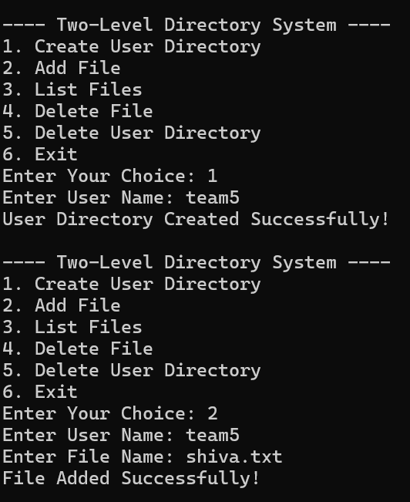
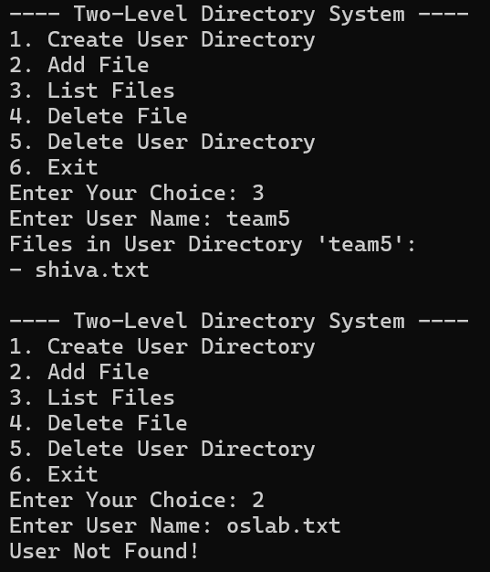
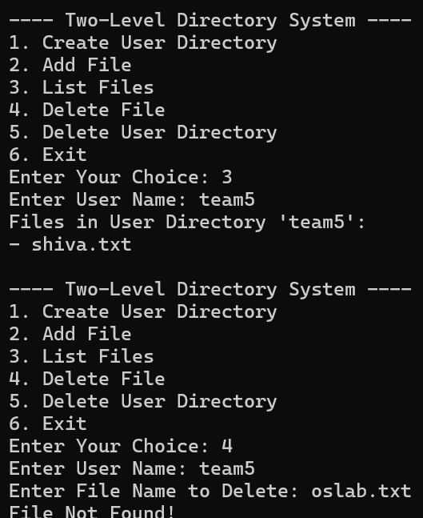
RESULTS
#DSC

Slide 10
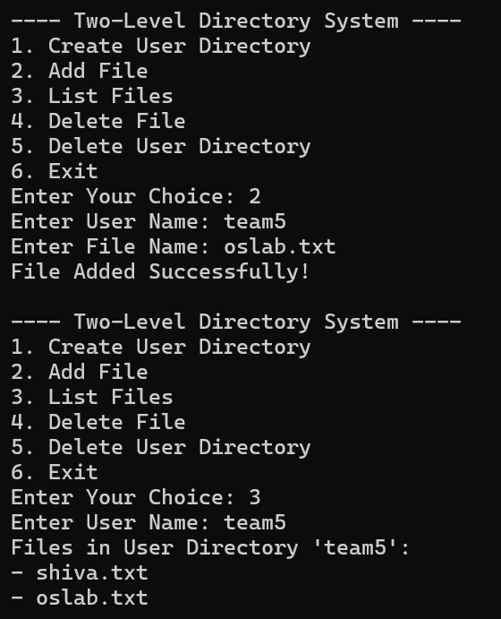
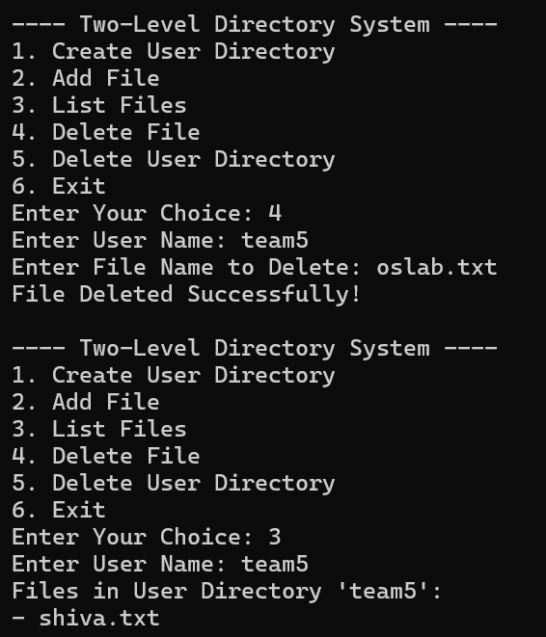
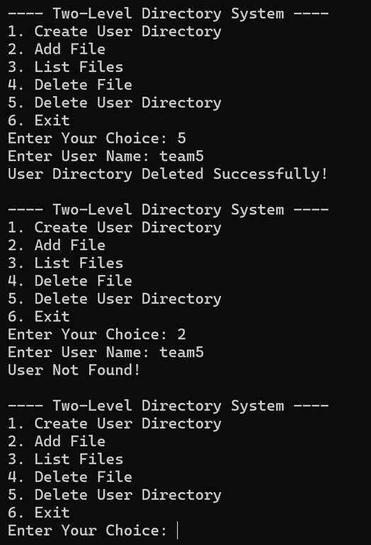
#DSC

Slide 11
Advantages
Provides hierarchical organization for better file management
Avoids name conflicts between files of different users
Makes file searching and access more efficient
Limitations
Scalability issues when handling a large number of directories or files.
Fixed-size arrays may restrict the number of files or directories
Applications
Used for personal file management systems
Helpful in shared environments where multiple users need to organize files independently.
Educational purposes to understand hierarchical file systems
#DSC

Slide 12
conclusion
The two-level directory program demonstrates the basics of file organization through hierarchical structures. It is a simple yet effective system for managing files and directories, laying the foundation for more complex file systems like tree directories.
#DSC

Slide 13
Thank you very much!
#DSC

